Slide 1

Arresting the Runaway Growth in
State Criminal Law
Presentation to Civil Justice Reform Group
September 13, 2011
Marc A. Levin, Esq.
Director, Center for Effective Justice
Texas Public Policy Foundation (TPPF)
(512) 472-2700, mlevin@texaspolicy.com www.texaspolicy.com, www.rightoncrime.com

Slide 2

Introduction to the Texas Public Policy Foundation
TPPF Mission: Individual Responsibility, Free Enterprise, Limited Government, Private Property Rights
We apply these foundational principles to criminal justice, bringing together stakeholders and working with policymakers and allies across the spectrum.

Slide 3

The TPPF Portfolio
Fiscal and tax restraint
Civil justice reform (worked to enact loser pays in 2011)
Center for Tenth Amendment Studies
Deregulation of (over)regulated industries like insurance and utilities.
Center for Effective Justice launched in March 2005, Right on Crime in Dec. 2010

Slide 4
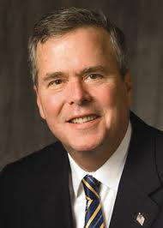
Right on Crime Enters the Field
Former Governor Jeb Bush, Speaker Newt Gingrich, Former Drug Czar Bill Bennett, Former A.G. Ed Meese, Grover Norquist, and Other Conservative Leaders Endorse Right on Crime Statement of Principles
Statement Supports Reining in Growth of Non-Traditional Criminal Laws, Cost-Effective Alternatives for Nonviolent Offenders, Emphasis on Restitution and Treatment, and Performance Measures.

Slide 5




Conservatives Latch on to Prison Reform
January 28, 2011
Right on Crime Noted
in “Budget Crunch
Forces New Approach
to Prisons”
February 15, 2011
National Review Praises Right on Crime
February 21, 2011

Slide 6

Overcriminalization Challenges at the State Level

Slide 7
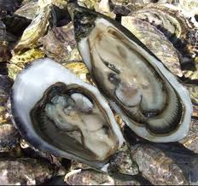
Regulatory Offenses on the Rise
No inventory of all state criminal laws is available, which itself adds uncertainty to the business climate.
We do know many states have thousands of criminal laws, including some 1,700 statutory offenses in Texas.
Texas has 11 felonies relating to harvesting oysters and in the gulf states of Texas, Louisiana, Mississippi, Alabama, and Florida, there are some 715 environmental criminal offenses alone.

Slide 8

The Withering Intent Requirement
Many of these laws dispense with the traditional requirement of a culpable mental state. For example, of the 83 environmental criminal offenses in Florida, 52 are strict criminal liability offenses.

Slide 9

Penalties Are Often Extreme
In Alabama, “disposing of scrap tires in a way not approved by the Environmental Management Act” is a felony punishable by up to ten years in prison, even if no harm.
Under the TX. Water Code, “transporting or causing or allowing to be transported for storage, processing, or disposal, any hazardous waste to any location that does not have all required permits” is punishable by up to ten years behind bars, even if the waste is not actually stored at the location that lacks permits and there is no harm.

Slide 10

The Dangers of Delegation
State offenses often confer virtually unlimited authority on agencies to effectively create new criminal offenses through their rulemaking.
For example, in Louisiana, RS 30:2421A creates an offense with a one year prison term for “disposing of white goods (appliances) except in a collection or recycling facility in accordance with the rules and regulations of the department.”

Slide 11
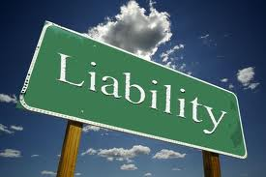
Vicarious Liability Offenses Make Doing Business Precarious
Alaska’s corporate criminal liability statute exposes organizations to criminal liability for the actions of their agents, as long as agents intended the organization to benefit from their actions.
It also specifies that organizations cannot disclaim liability through codes of conduct or corporate policies; their liability extends beyond any merger, consolidation, or dissolution; and that convicted organizations can be subjected to larger fines than the convicted individual.

Slide 12

Solutions to Rein in Overcriminalization at the State Level

Slide 13
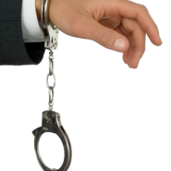
Reduce and Revise Criminal Laws
Stop creating new criminal offenses as a method of regulating business activities. Regulation is better handled through non-criminal administrative mechanisms and market forces, not the heavy stigma of criminal sanctions
Revise criminal laws to remove ambiguities and consolidate redundant laws to help prevent prosecutorial abuse.

Slide 14
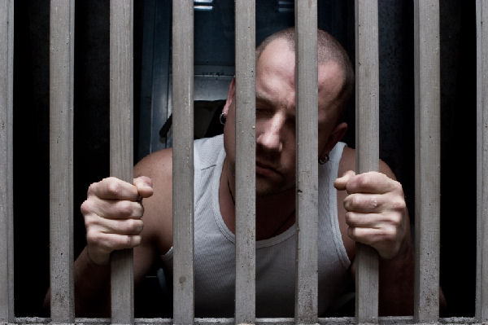
Narrow What’s Criminal and Jailable
Convert many regulatory misdemeanors into civil violations or, at the least, remove jail time as an option for such offenses, provided that the non-jail penalty is satisfied.
Economic conduct should be criminal only when it results in actual harm or danger, except if there is intentional fraud such as Madoff.

Slide 15
Establish Interim Committees
Create interim committees and commissions to develop and submit comprehensive, consensus reform packages to lawmakers at the beginning of legislative sessions.
These bodies would identify criminal laws that are unnecessary, duplicative, overbroad, excessively vague, lacking an appropriate culpable mental state, create vicarious liability, or are otherwise deficient, and incorporate their work into one omnibus bill.
An interim commission in 2010 in South Carolina resulted in a package enacted almost unanimously by lawmakers that included significant sentencing and probation reforms relating to traditional criminal offenses.

Slide 16

Enact ALEC Model Intent Rule
Applies default rule that the following culpable mental state applies to all elements of the offense if one is not provided in the statute:
(a) with the conscious object to engage in conduct of the nature constituting the element;
(b) with the conscious object to cause such a result required by the element;
(c) with an awareness of the existence of any attendant circumstances required by the element or with the belief or hope that such circumstances exist; and
(d) with either specific intent to violate the law or with knowledge that the person’s conduct is unlawful.

Slide 17
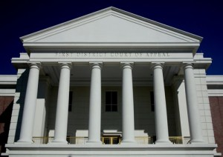
Enact ALEC Rule of Lenity Model Bill
This due process protection provides that state laws are construed against the government when there is doubt as to whether the Legislature intended to criminalize the conduct at issue, ensuring there is fair notice concerning the line between legal and criminal behavior.
Parallels conservative emphasis on strict interpretation of Constitution.

Slide 18
Institute Procedural Safeguards to Slow Growth in New Criminal Laws
Require proposed legislation that creates or enhances an offense to expressly note this in its caption, include a comprehensive fiscal note on the costs to state government, local governments, and the private sector (industry and consumers).
Require approval of new offenses and sentencing enhancements by the legislative committees overseeing criminal justice system.
Require sunrise review of new proposals similar to the sunset process, which is done for certain measures such as those involving occupational licensing in states like Arizona and Oregon.

Slide 19
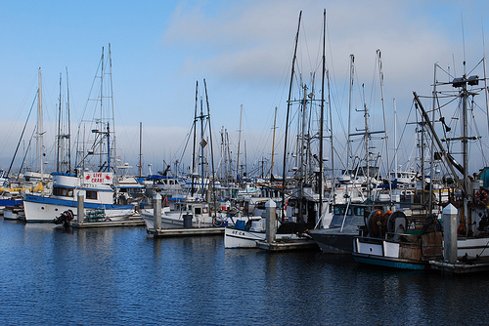
Create Safe Harbor Statutes
These statutes, such as Section 7.03 of the Texas Water Code, can prevent local prosecutors and the Attorney General from bringing a prosecution when the same conduct is the subject of pending or resolved administrative proceeding before a state agency.

Slide 20

Demand Prosecutorial Transparency
Statutes should require that attorney generals, as well as local prosecutors whose offices receive state funds, submit reports similar to other agencies accounting for the time and money spent on various types of cases, separating expenses on criminal cases involving crimes in the Penal Code versus those involving regulatory offense that do not directly implicate public safety.

Slide 21

Deter Prosecutorial Misconduct
Remove fiscal incentives to bring criminal cases. Arrangements in some states that allow a division within the office of the Attorney General or prosecutor to keep the “winnings” from settlements or fines in cases should be repealed.
Review state bar rules and processes relating to prosecutorial misconduct to ensure there are sufficiently strong statutes and actual enforcement occurs.

Slide 22

Strengthen Informal Processes
Expand the availability of informal processes for expeditious case resolution such as mediation and create a presumption for the use of such processes in appropriate cases.
Mediation is confidential, not an admission of wrongdoing, and resolution must be restorative not punitive. Options are restitution and/or community service.

Slide 23

Suppressing Unnecessary Arresting
Prohibit arrest for regulatory misdemeanors unless the charged individual fails to respond to a summons or emergency danger to humans.
Being arrested can create a permanent record, compromise an individual’s ability to defend themselves, and be used in cases to gather personal information and effects when a court might not have found sufficient basis for a search warrant.

Slide 24

Taking the Next Steps to Turn Ideas into Action

Slide 25
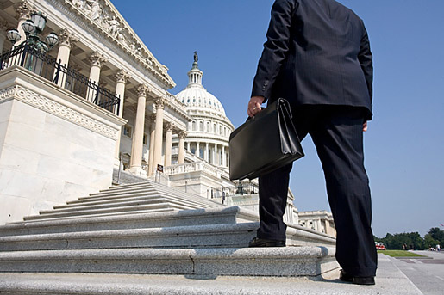
What We Can Do to Advance Reforms
TPPF and Right on Crime partners with State Policy Network member think tanks, which exist in all 50 states.
Continued efforts through ALEC and outreach to NCSL, state business groups.
Conduct additional research, issue papers, and identify specific cases to spotlight in discussing the issue with lawmakers and media.

